Slide 1
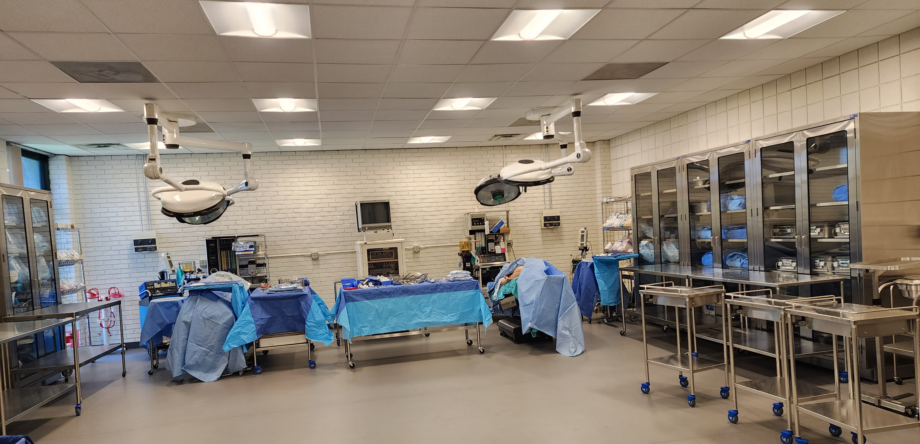
SUNY NIAGARA
SURGICAL TECHNOLOGY PROGRAM

Slide 2
SURGICAL TECHNOLOGY
The Program
2-year, college-based program leading to an A.A.S. degree in Surgical Technology.
Commission on Accreditation of Allied Health Education Programs (CAAHEP) Accredited Surgical Technology Program.
  Graduates are eligible to take the NBSTSA Certifying Surgical Technologist (CST) Examination.
  In New York State, all graduates are mandated to be credentialed as a Certified Surgical Technologist (CST) in order to be employed.
    SUNY Niagara offers the NBSTSA Certifying Surgical Technologist Exam on campus to the graduating class.

Slide 3
SURGICAL TECHNOLOGY
Prospective (Future) Surgical Technology (ST) Students:
In Spring/Summer 2026: Students interested in the ST Program will be accepted into Liberal Arts and Science (LAS) Program.
  LAS students interested in the ST program must enroll in the Allied Health Perioperative I (AHP 100E/L) and Anatomy and Physiology I BIO 213 E/L (A&P I) (both lecture and laboratory) in Fall 2026 (Pre-requisite semester).
    Students will automatically be considered for the ST Program and only those who successfully earn a C grade or higher in the Allied Health Perioperative I (AHP 100E/L) and Anatomy and Physiology I BIO 213 E/L (A&P I) in December 2026.
    Students need to earn a C grade or higher for AHP 100E/L, ALL SUR core courses and BIO courses to be eligible to graduate from the ST program.
    If college-level courses were completed prior to the student starting in the ST program and the courses are to be used to fulfill degree requirements, a minimum ST program grade-point average of 2.0 is required to be eligible to graduate.

Slide 4
SURGICAL TECHNOLOGY
In Fall 2026: Pre-requisite semester with acceptance (curriculum change) into the Surgical Technology (ST) Program and advisement session will occur in December 2026 for Spring 2027: for students who only successfully earn a C grade or higher in the Allied Health Perioperative I (AHP 100 E/L) and Anatomy and Physiology I BIO 213 E/L (A&P I) (both lecture and laboratory).
  The following pre-requisite courses that may be met concurrently are:
      Anatomy and Physiology I: BIO 213 E/L (A&P I) (both lecture (4 credits) and laboratory (1 credit).
      Allied Health Perioperative I (AHP 100 E/L) (4 credits)
      HED elective (3 credits)
      Medical Terminology (MED 134) (3 credits)
  ONLY 50 slots are available for Spring 2027:
    This is determined according to the students AHP I00 E/L and BIO 213 E/L (A&PI) (both lecture and laboratory) with a minimum C grade or higher and ST application date.
    Annual Health records/Immunizations/Titer requirements approval through the SUNY Niagara Wellness Center.
    Certification of Basic Life Support for Professional Rescuer or Basic Life Support Provider and must remain current throughout the entire program.
  All applicants must meet the following admission requirements for the ST Program:
    High school diploma or equivalency diploma.
    Applicants will be tested for Academic Foundations in reading and mathematics. To be accepted into the program, applicants must earn the minimum required score on these tests or pass the Academic Foundations course listed: Will need to pass ENG 099, AAC 042, and MAT 012

Slide 5
SURGICAL TECHNOLOGY
In Spring 2027: Students are enrolled in the ST Program where ST courses will begin:
  Surgical Technology II (SUR 104E) Lecture (7 credits total)
  Surgical Technology II (SUR 104C) Clinical 2 Days per week
    Open laboratory sessions offered at various times
  Anatomy and Physiology II BIO 214 Lecture (4 credits) and Laboratory (1 credit)
  Writing I (ENG 101) (3 credits)
In Fall 2027: Students are enrolled in the ST Program where ST courses continue:
  Surgical Technology III (SUR 200E) Lecture (7 credits total)
  Surgical Technology III (SUR 200C) Clinical 2 Days per week
    Open laboratory sessions offered at various times
  Microbiology (BIO 221E/L) Lecture and Laboratory (4 credits)
  Introduction to Psychology (PSY110) (3 credits)
In Spring 2028: Students are enrolled in the ST Program where ST courses continue:
  Surgical Technology IV (SUR 204E) Lecture (7 credits total)
  Surgical Technology IV (SUR 204C) Clinical 2 Days per week
    Open laboratory sessions offered at various times
  Introduction to Sociology (SOC 101) (3 credits)
  Basic Oral Communication Elective (3 credits)
  MAT Elective (3 credits)
Clinical (hospital experience): at
        NFMMC
        Catholic Health System (CHS)
        Kaleida Health System
        ECMC

Slide 6
SURGICAL TECHNOLOGY
The Profession
Surgical Technologists are allied health professionals who are an integral part of the surgical team. They are responsible for a safe patient and surgical environment.
Surgical Technologists:
    Maintain the sterile field.
    Assist in various surgical procedures.
    Sterile members of the surgical team, who pass instruments, sutures and sponges during surgery.
2025 NBSTSA CST Examination Pass rate is 87%
2025 NCCC Surgical Technology Graduate placement is 93%
Average US median wage:
  $28.00-$30.00

Slide 7
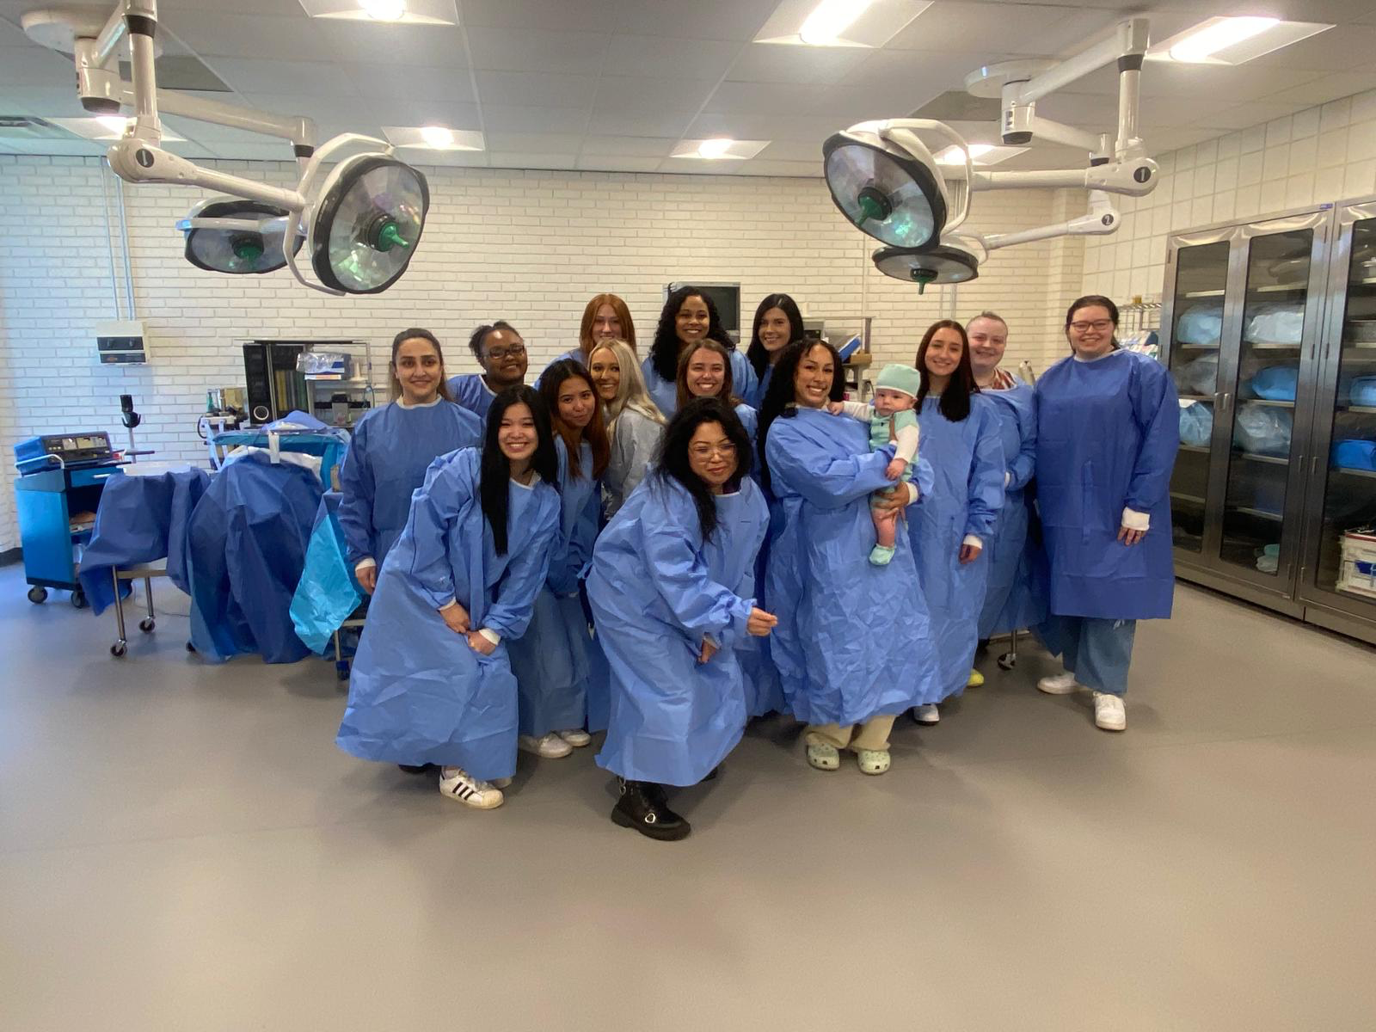
SUNY Niagara Surgical Technology Program
Class of 2024
NBSTSA CST Examination Pass Rate
100%

Slide 8
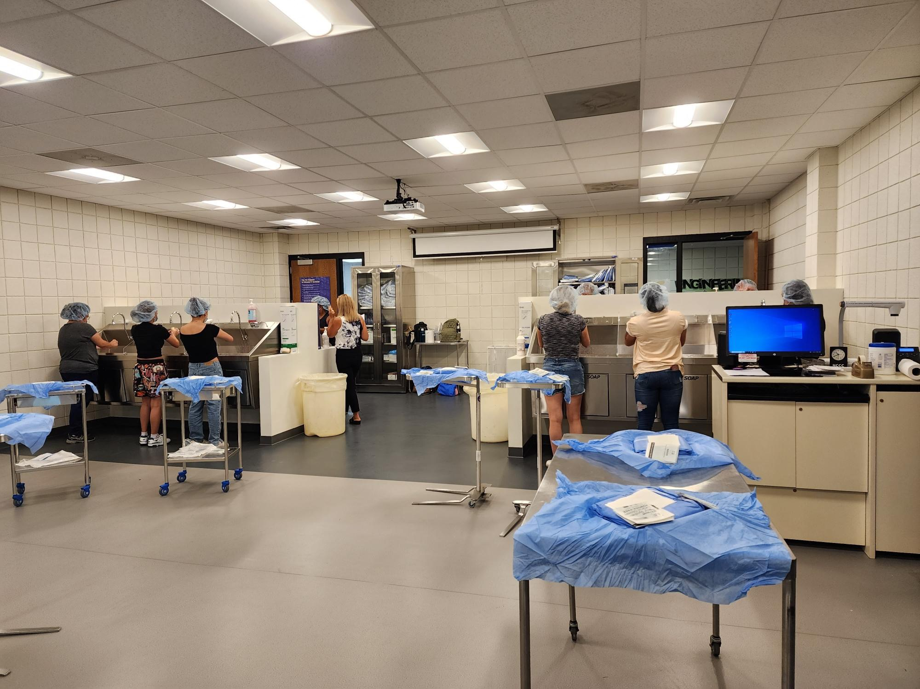
SURGICAL TECHNOLOGY

Slide 9
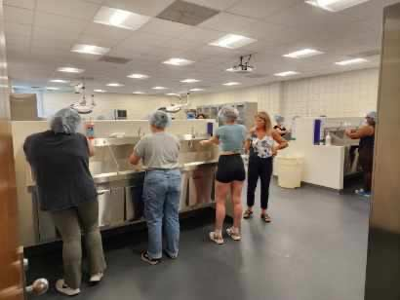
SURGICAL TECHNOLOGY

Slide 10
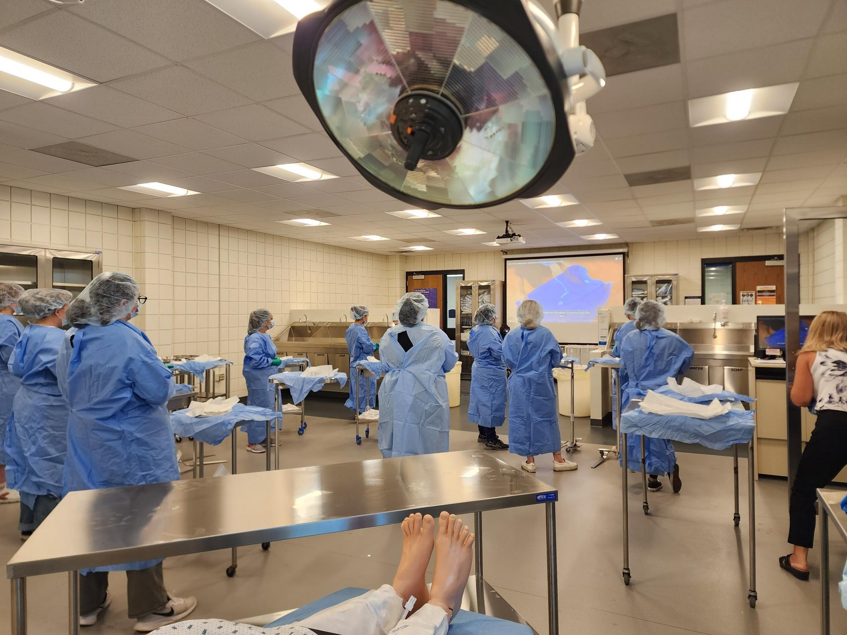
SURGICAL TECHNOLOGY

Slide 11
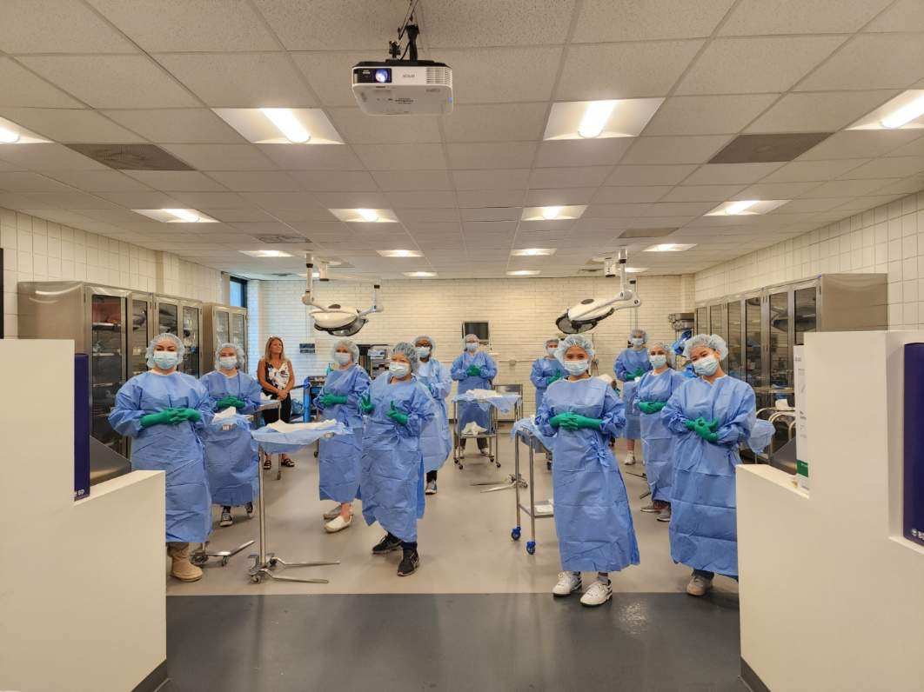
SURGICAL TECHNOLOGY

Slide 12
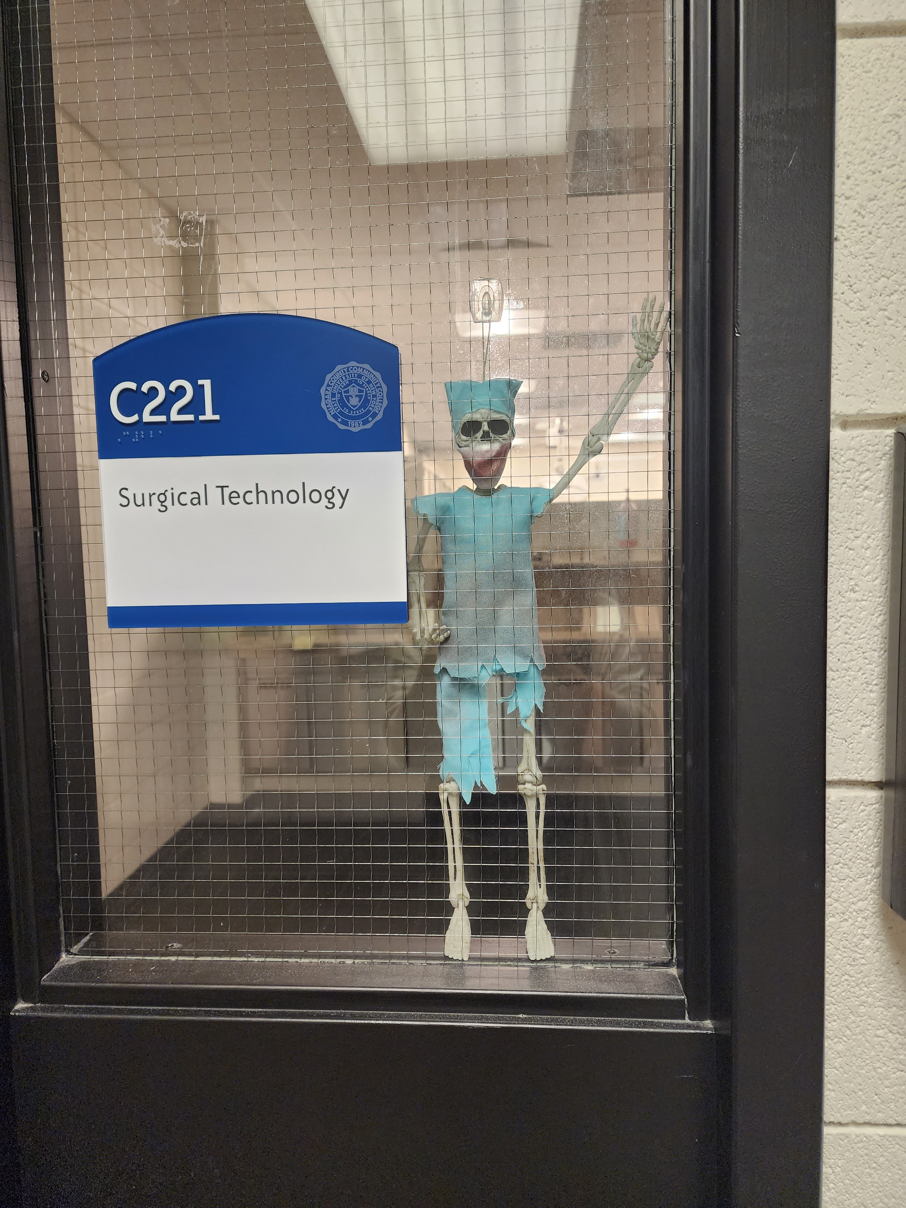

SURGICAL TECHNOLOGY
Please visit the
Surgical Technology Program on the SUNY Niagara website
For more information email
Jaelle Goldberg, DC, CST
Surgical Technology Program Coordinator/Professor
jtgoldberg@niagaracc.suny.edu

